Slide 1
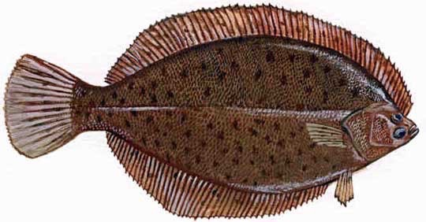
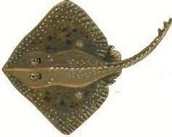
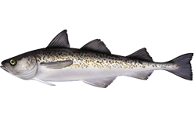

From local to regional: spatial scaling of long-term diversity and stability in the Gulf of Alaska groundfish community
Colette L. Ward Rachael E. Blake
National Center for Ecological Analysis & Synthesis, University of California Santa Barbara
Mary Hunsicker, A. Ole Shelton, Anne Hollowed
Northwest Fisheries Science Center, National Oceanic & Atmospheric Association
Eric Harvey, Owen L. Petchey
Department of Evolutionary Biology & Environmental Studies, University of Zürich

Slide 2
Stability
Diversity
Notes:
- Local scale: The relationship between diversity and stability has been well studied and its underlying mechanisms are relatively well-understood

Slide 3
Stability
Diversity
(Species Richness)
Notes:
- here, diversity = species richness
begets stability via either asynchrony in species responses to environmental fluctuations
or statistical averaging of random fluctuations in species abundances
- Mechanisms: portfolio effect, insurance hypothesis, negative covariance hypothesis

Slide 4

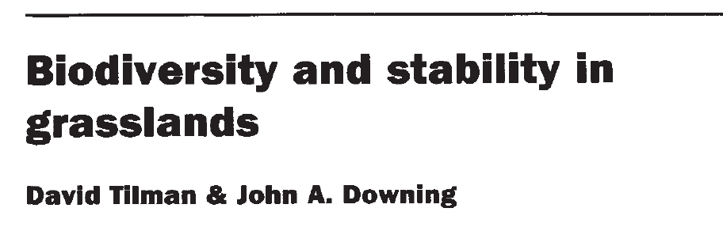
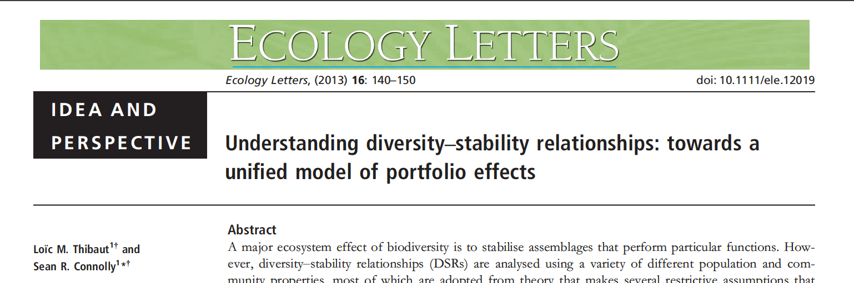
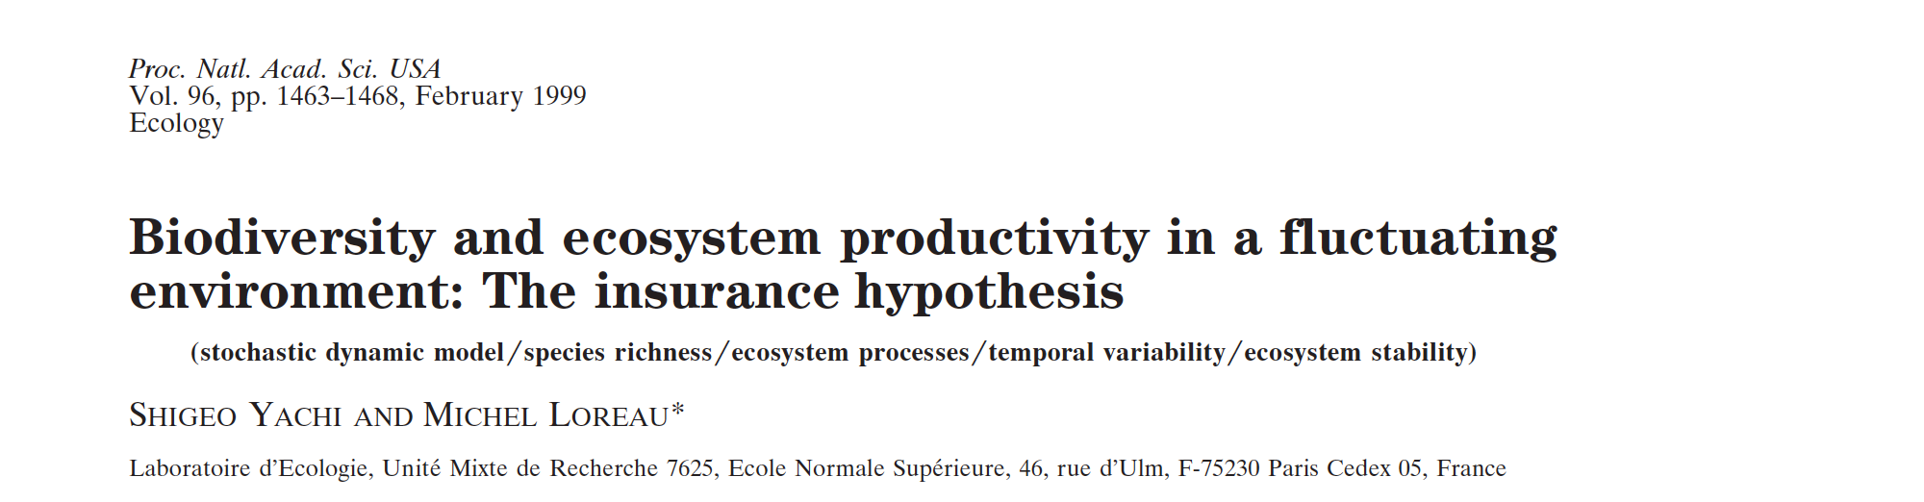
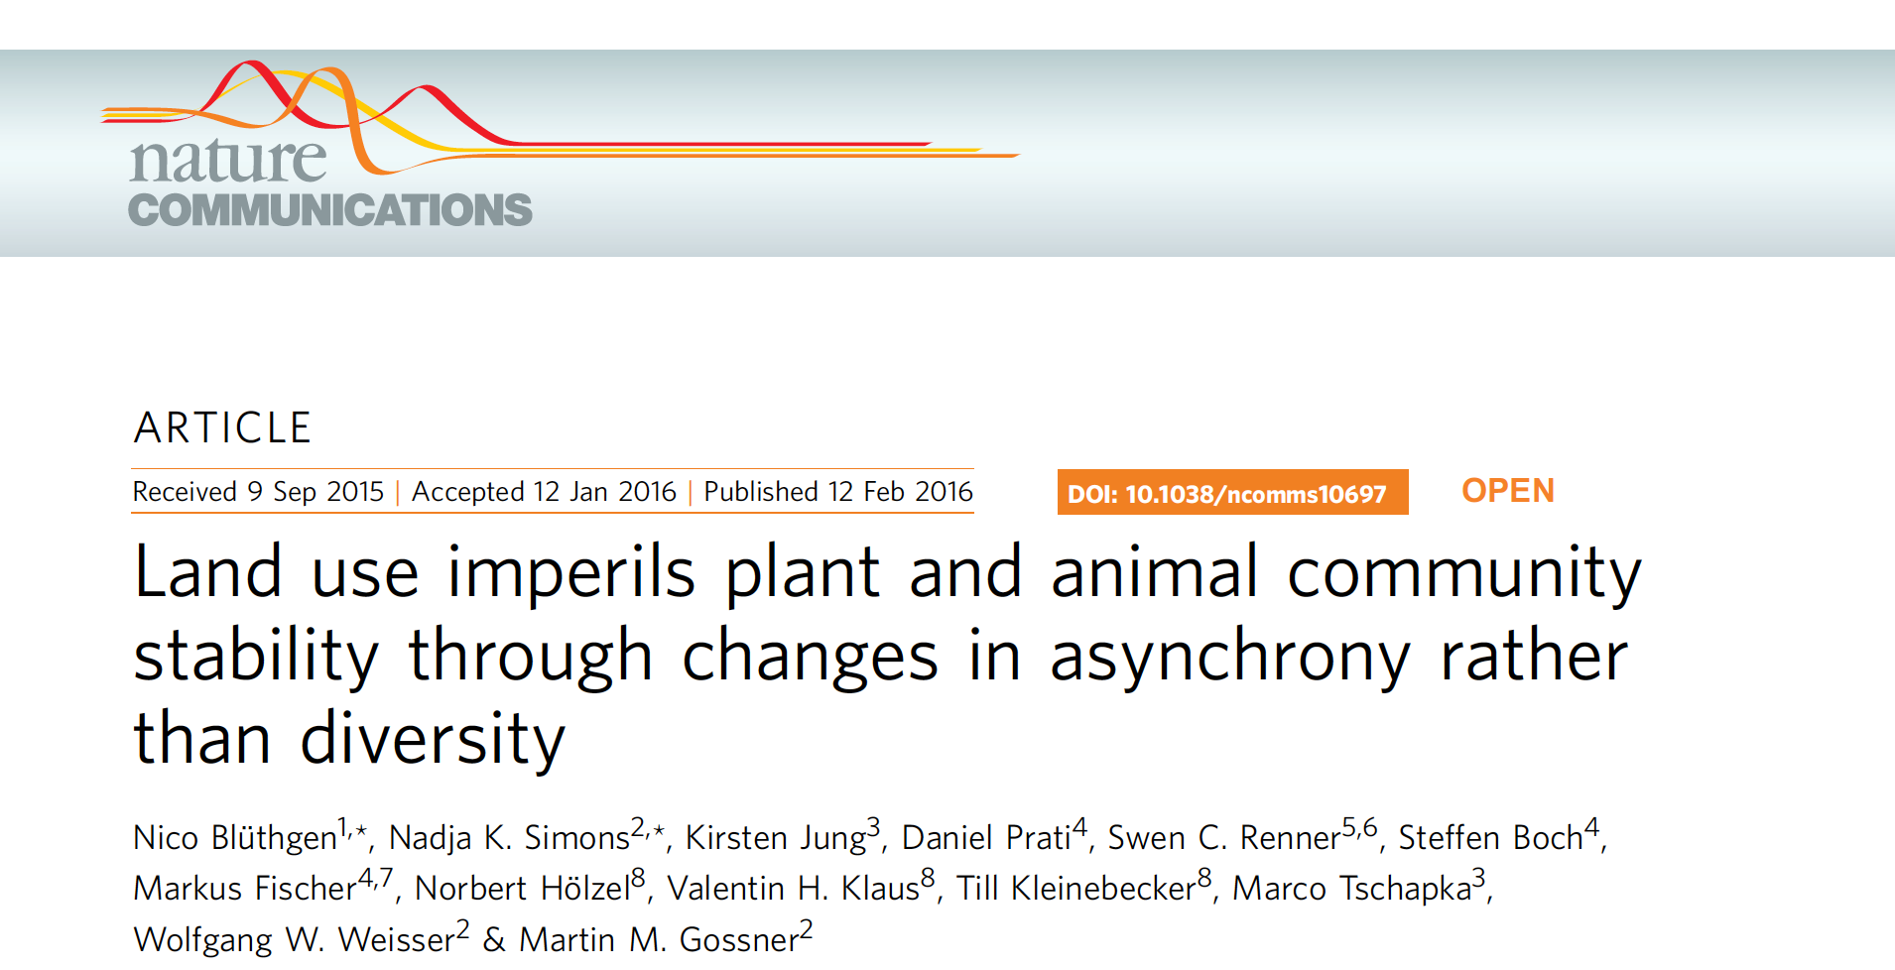
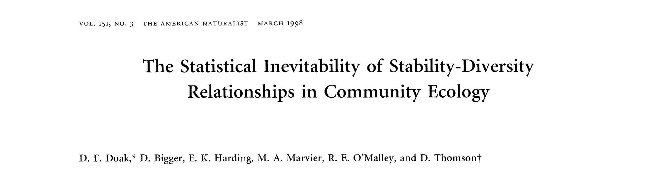
Notes:
LOTS of papers …

Slide 5
Regional Stability
Between-Patch (Beta) Diversity & Variation
Local Diversity & Variation
Diversity
Wang & Loreau 2014 Ecol. Letts.
Notes:
regional = collection of local communities
We’ve thought a lot less about what happens at the regional scale
here, any relationship between diversity and stability can arise via multiple different pathways
modified this framework a little bit from a paper by Shaopeng Wang and Michel Loreau
they advocate that the path from diversity to stability at the regional scale can arise from processes at the scale of local communities and / or processes happening at the between-community scale (the beta scale)

Slide 6
Regional Stability
Local
Beta
Asynchrony between species
Species temporal variability
Asynchrony between communities
Spatial turnover in species identity
Diversity
modified from Wang & Loreau 2014 Ecol. Letts.
Notes:
more specifically, we can decompose these local & beta mechanisms into …

Slide 7

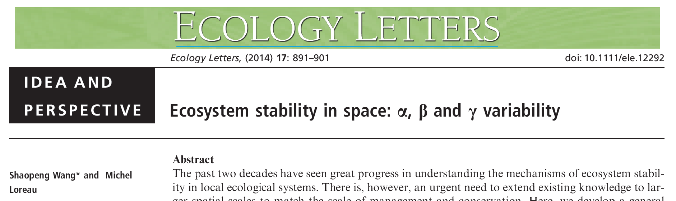
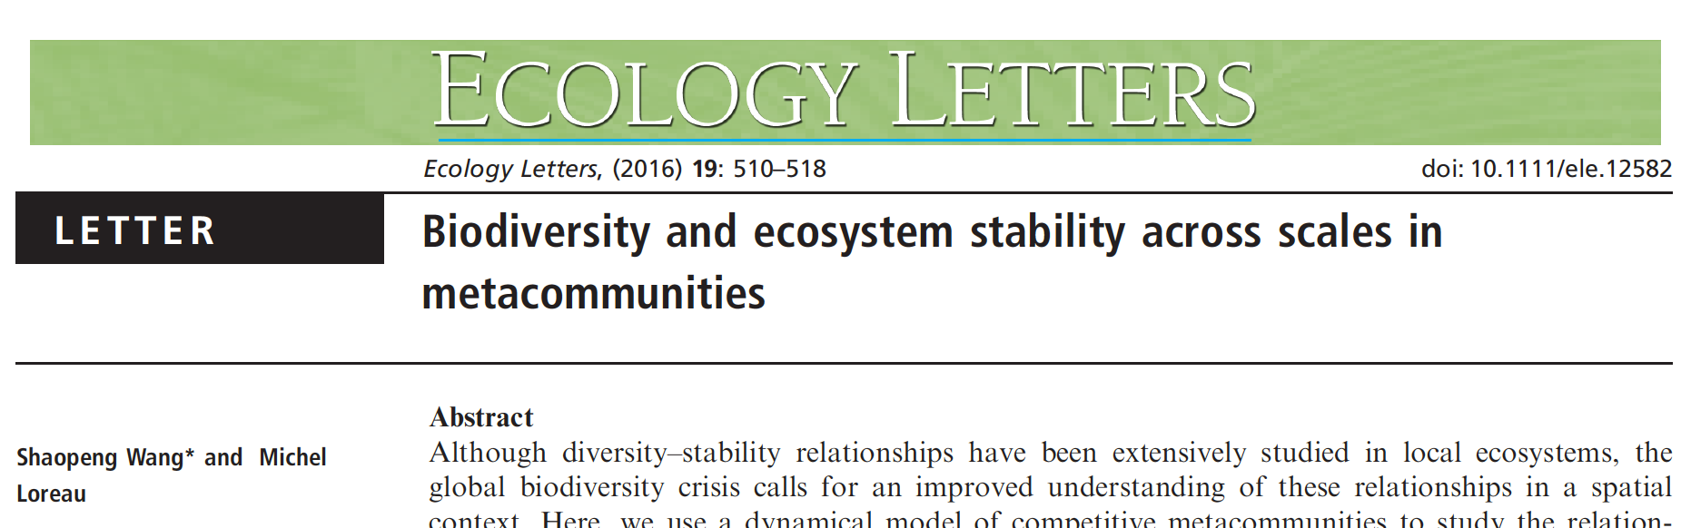
Notes:
relatively new idea , very little work on this … a little bit of theory, really only 1 empirical paper that we know of

Slide 8
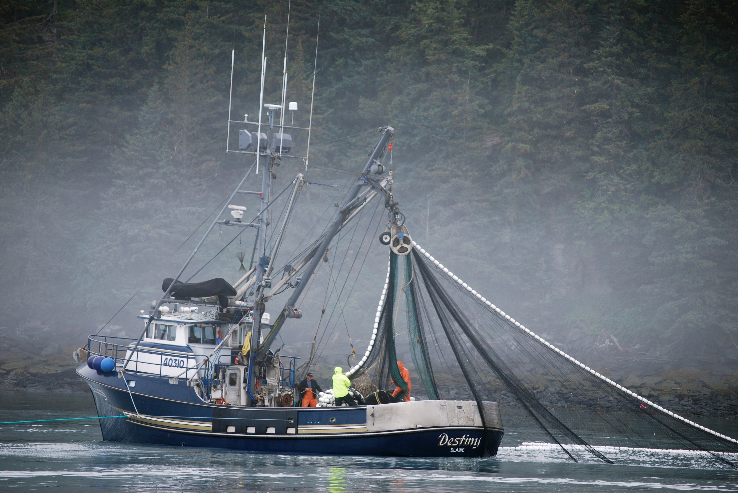
Management priorities:
Local species richness?
Spatial differences in species identity?
Notes:
which of these mechanisms is dominant can be very important to inform which management practices will be best to maximize stability.
if you’re a natural resource manager seeking to maximize ecosystem stability, should you prioritize local species richness? spatial turnover in community composition? both?

Slide 9
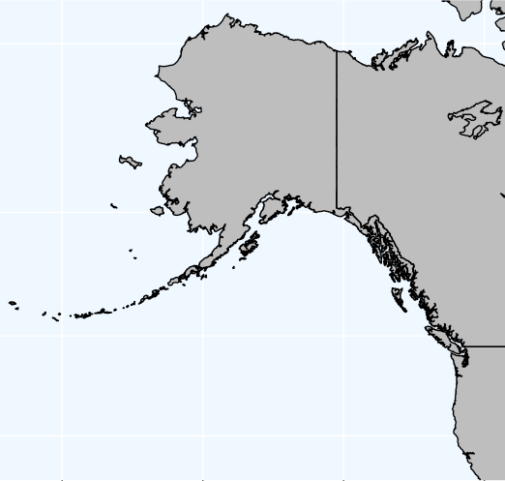

Slide 10
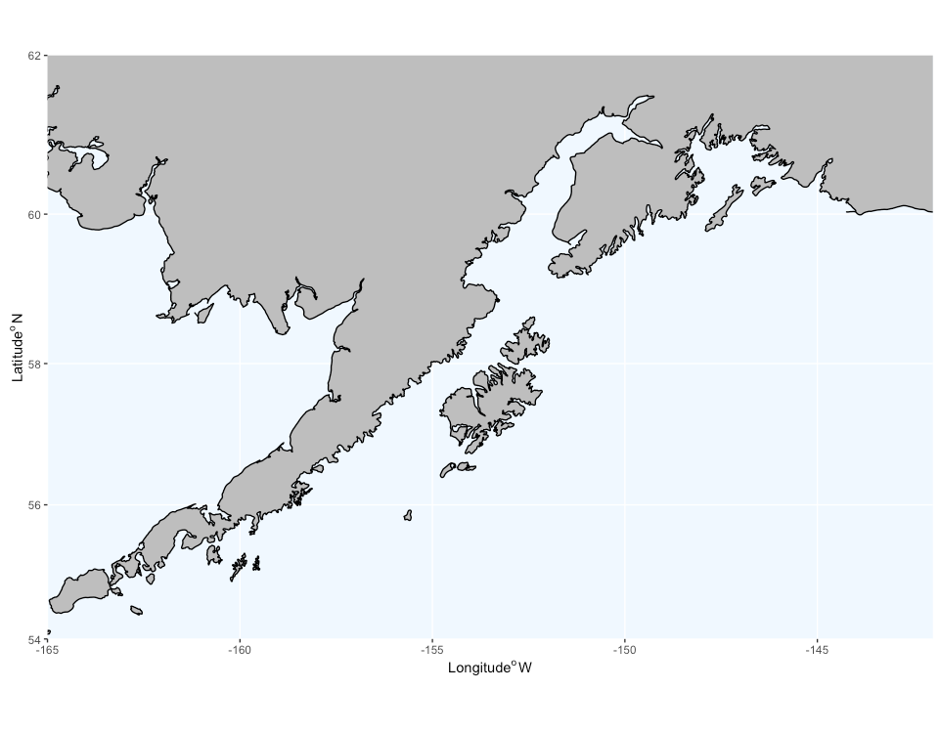
Notes:
Continental shelf …
ACC, PDO; spatial variation in primary production, freshwater input, fishing pressure
- very well-sampled by NOAA’s bottom trawl survey since 1984

Slide 11
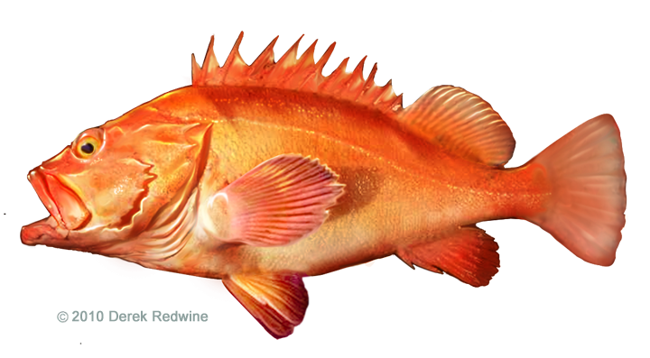
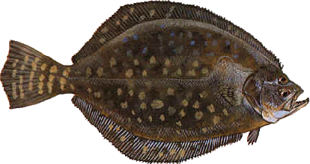
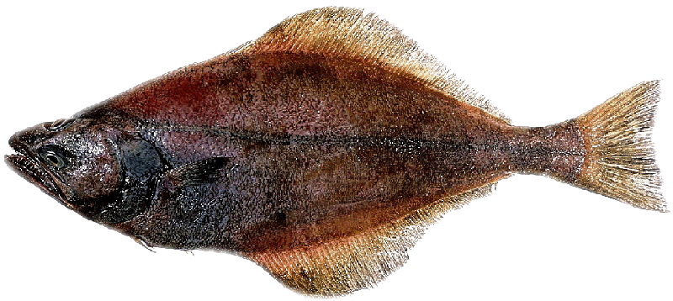
The Data: Relative Abundances (CPUE)
NOAA Bottom trawl survey (demersal species): Tri- and biennial data, 1984-2015 7601 tows Stratified random sampling design

Slide 12
The Data: Relative Abundances (CPUE)
NOAA Bottom trawl survey (demersal species): Tri- and biennial data, 1984-2015 7601 tows Stratified random sampling design
Geostatistical correction using INLA (Integrated Nested Laplace Approximation)
Notes:
lays a grid of fixed points over the region, and projects survey data onto those points
- corrects for between-year differences in sampling location & depth
- data were projected on an Albers grid of fixed points to correct for between-year differences in sampling location & depth
Because we’re interested in spatial distributions, not depth distributions:
the model treated year and depth as fixed effects on CPUE, because most groundfish exhibit spatial patterns related to depth. Including depth as a fixed effect corrects for species-specific affinities for a given depth range. The estimated range at which the spatial correlation in the spatial field falls to 0.05 after accounting for depth ranged from 10 km – 500 km with most species exhibiting a range of 65 km.

Slide 13
The Data: Relative Abundances (CPUE)
NOAA Bottom trawl survey (demersal species): Tri- and biennial data, 1984-2015 7601 tows Stratified random sampling design
Geostatistical correction using INLA (Integrated Nested Laplace Approximation)
Using the 53 most numerically dominant species (species observed in ≥ 3% of tows)
Notes:
omitting rare species

Slide 14
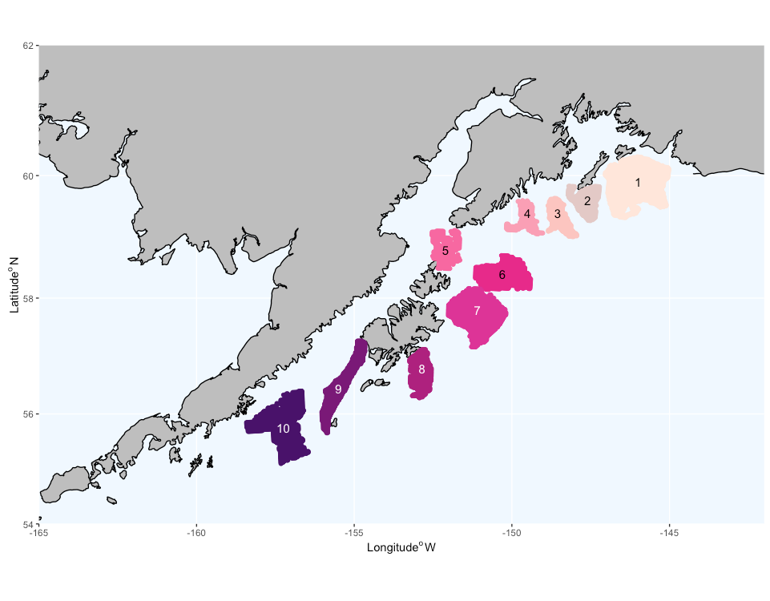
Notes:
divided the region into 10 local communities
these are all 50-150m depth, distinct areas separated by canyons or stretches of deeper areas
- 1000 km end-to-end

Slide 15
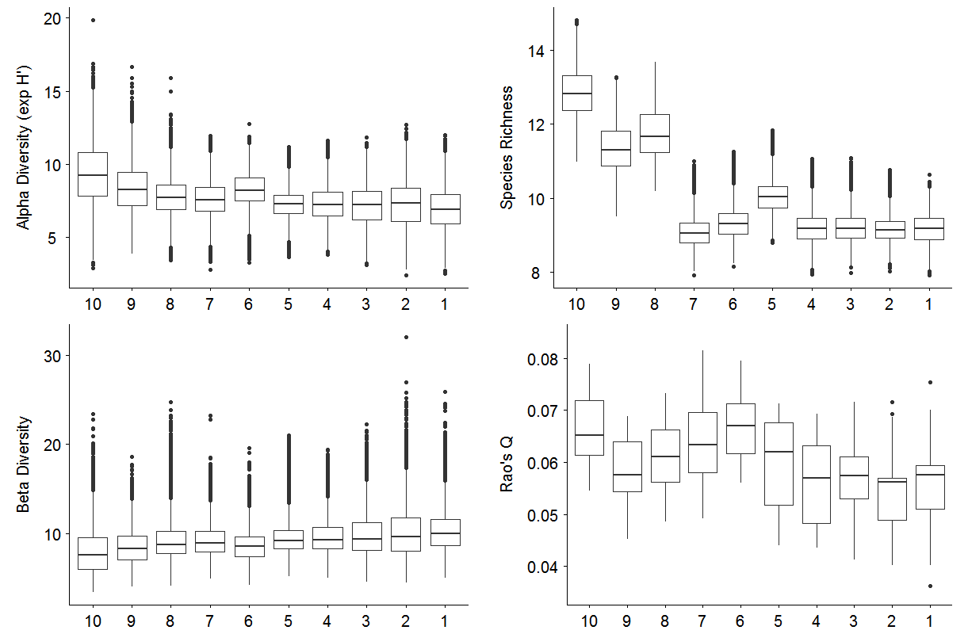
Diversity metrics are (mostly) invariant across local communities
Alpha Diversity (Exp H’)
Notes:
look at local diversity metrics across the region
local communities are ordered west to east
bootstrapped values
diversity in local communities is similar across the region
here: alpha diversity (exponent of the Shannon-Weiner index, i.e. effective number of species) (eveness)

Slide 16
Diversity metrics are (mostly) invariant across local communities
Alpha Diversity (Exp H’)
Beta Diversity (γ / α)

Slide 17
Diversity metrics are (mostly) invariant across local communities
Alpha Diversity (Exp H’)
Beta Diversity (γ / α)
Functional Diversity (Rao’s Q)
Notes:
diversity of functional traits – Rao’s quadratic entropy (a few pairwise differences, otherwise invariant across local communities)
Rao’s Q, function of between-species distance matrix for traits, and species relative abundances
Used orthogonal, uncorrelated traits
Not corrected for species richness, since similar between patches

Slide 18
Diversity metrics are (mostly) invariant across local communities
Alpha Diversity (Exp H’)
Beta Diversity (γ / α)
Functional Diversity (Rao’s Q)
Species Richness (∑ probability of occurrence)
Notes:
exception is species richness (based on probability of occurrence): greater richness in these 3 western-most areas with lower primary production

Slide 19
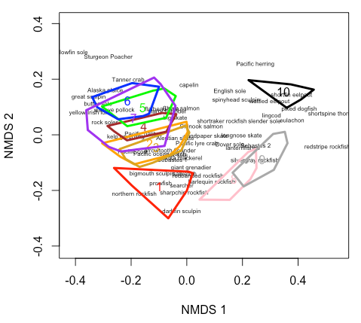
Strong spatial turnover in community composition
Notes:
intriguing: despite these similarities, there is strong spatial turnover in species identity (community composition) along the East-West gradient
these are results of NMDS … each of these hulls encompasses the ordination of each local community in each year (eg comm 1 in 1984, in 1987, 1990, etc )
distance between objects indicates dissimilarity
- goa: change in identity but not other div or functional div

Slide 20
Regional Stability
Local
Beta
Asynchrony between species
Species temporal variability
Asynchrony between communities
Spatial turnover in species identity
Diversity
modified from Wang & Loreau 2014 Ecol. Letts.

Slide 21

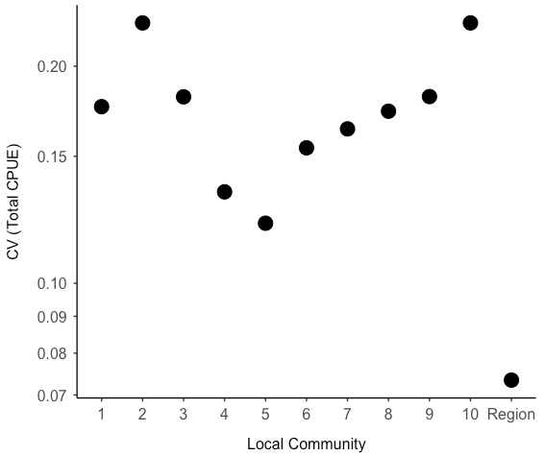
The regional metacommunity is more stable than local communities
less stable
CV (Total Community CUE)
more stable
Local Community
Notes:
stability: coefficient of variation (CV) of total community CUE
CV in each local community vs the region as a whole: the regional metacommunity is more stable than any of the local communities
- how do we get from here to here.

Slide 22
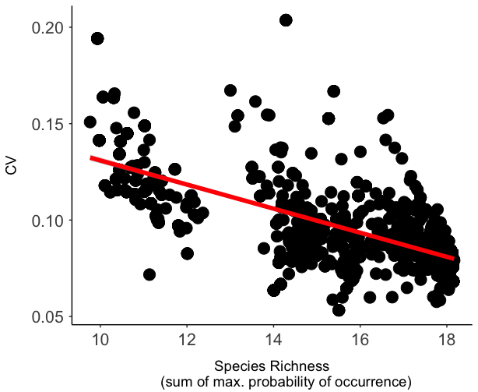
CV (Total Community CUE)
Species Richness (∑ max. probability of occurrence)
Notes:
species richness vs stability: there IS a relationship
But there are actually multiple pathways that can take us from diversity to stability

Slide 23
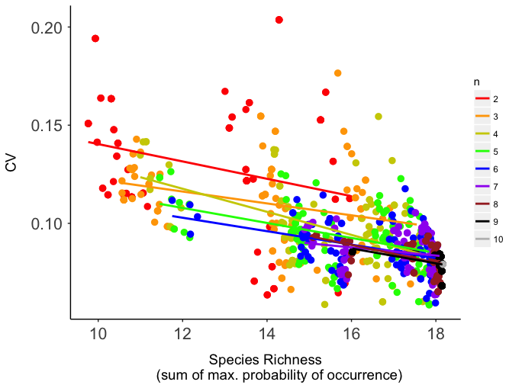
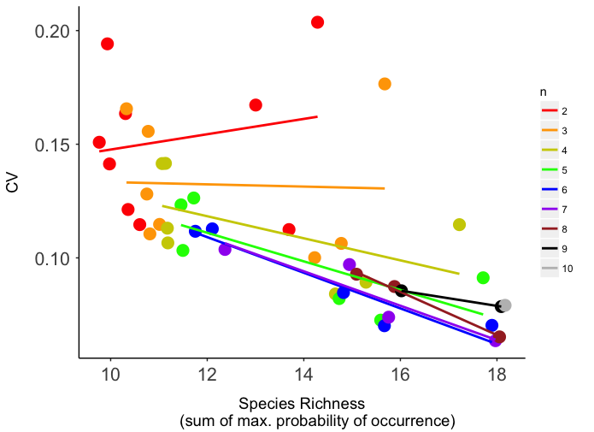
Random aggregations
Spatially-nested aggregations

Slide 24
Regional Stability
Local
Beta
Asynchrony between species
Species temporal variability
Asynchrony between communities
Spatial turnover in species identity
Diversity
modified from Wang & Loreau 2014 Ecol. Letts.

Slide 25
Stability
Local
Beta
C
C
CV
Asynchrony (between-species)
Diversity
Notes:
expected direction of relationships with stability if each of these mechanisms is supported
At the local level:
we should see greater stability (lower CV) with greater Asynchrony between species

Slide 26
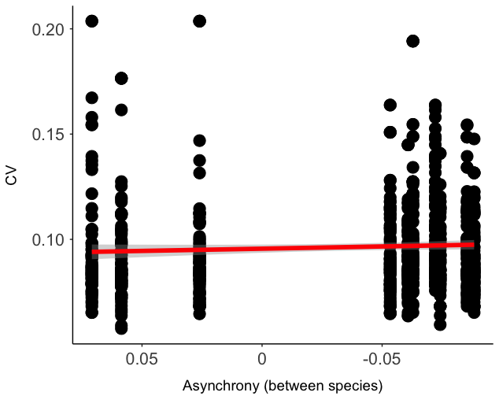
Local
Beta
CV (Total Community CUE)
Asynchrony (between-species)
Notes:
points represent 100 random draws of each level of spatial aggregation of our 10 local communities.
(100 random draws of 2 communities, 3 communities, 4 communities, etc, up to 8 communities. and then 9 and 10 are represented once because there are only a few (or one) possible combination of local communities.
using the synchrony index from Kevin Gross’ 2014 paper
mean synchrony = mean correlation coefficient r between the abundance of each species versus the rest of the community
-1 = perfect asynchrony, +1 = perfect synchrony, 0 = species fluctuate independently
- these values are all quite close to zero, suggesting that, at the local level, on average, between-species fluctuations are not synchronous, not Asynchronous, but instead fluctuating independently of each other.

Slide 27
Stability
Local
Beta
C
C
CV
Asynchrony (between-species)
CV
Species Variability
Diversity
Notes:
Still at the local level, stability should decline as species-level variation increases

Slide 28
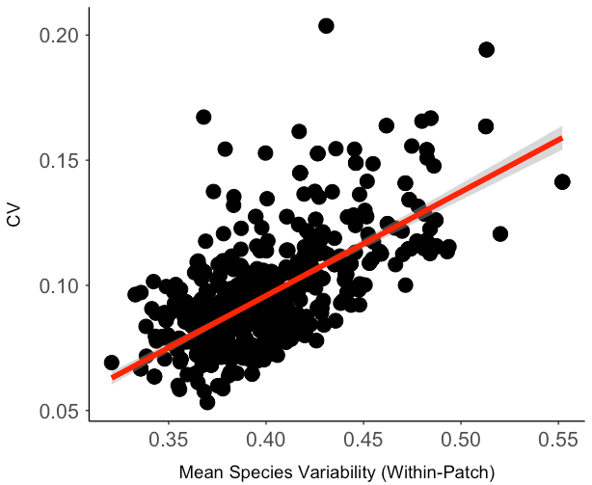
Local
Beta
CV (Total Community CUE)
Asynchrony (between-species)
CV (Total Community CUE)
Mean Species Variability (within-patch)
Notes:
support for this mechanism as well.
using the formula for within-patch mean species variability from Shaopeng Wang & Michel Loreau’s 2014 paper

Slide 29
Stability
Local
Beta
C
C
CV
CV
Asynchrony (between-species)
Asynchrony (between-patch)
CV
Species Variability
Diversity
Notes:
At the beta level:
should see greater stability with greater Asynchrony BETWEEN local communities

Slide 30
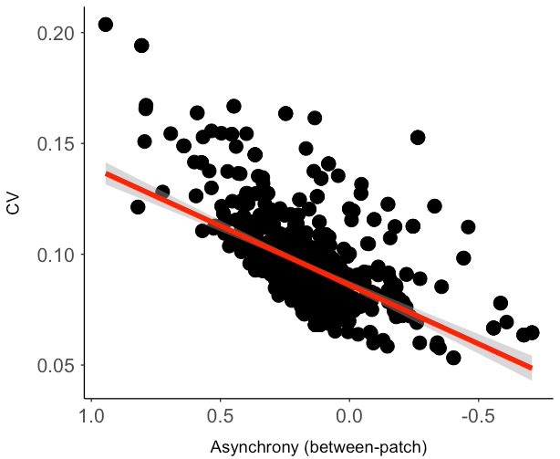
Local
Beta
CV (Total Community CUE)
CV (Total Community CUE)
Asynchrony (between-species)
Asynchrony (between-patch)
CV (Total Community CUE)
Mean Species Variability (within-patch)
Notes:
Asynchrony here is again the Kevin Gross index of synchrony
-1 = perfect asynchrony, +1 = perfect synchrony, 0 = species fluctuate independently
these values have quite a large spread relative to those for between-species asynchrony

Slide 31
Stability
Local
Beta
C
C
CV
CV
Asynchrony (between-species)
Asynchrony (between-patch)
CV
CV
Species Variability
Species Turnover (between-patch)
Diversity
Notes:
Finally we should also see greater stability when there is more spatial turnover in species identity

Slide 32
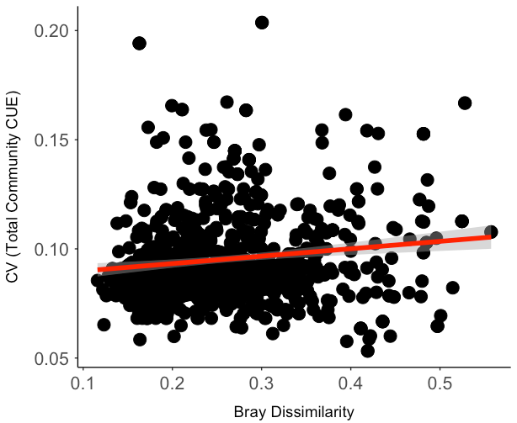
Local – Random Aggregations
Beta – Random Aggregations
CV (Total Community CUE)
CV (Total Community CUE)
Random Aggregations = 100 random draws of 2, 3, … 8 local communities + a few for 9 – 10 local communities
Asynchrony (between-species)
Asynchrony (between-patch)
CV (Total Community CUE)
CV (Total Community CUE)
Mean Species Variability (within-patch)
Species Turnover (Bray Dissimilarity)
Notes:
Instead the data show a WEAK relationship going in the opposite direction.
this is species turnover (spatial turnover in community composition between communities) measured using a Bray-Curtis dissimilarity index (Wisconsin double standardization)
relative importance …
some of these relationships are tighter than others.

Slide 33
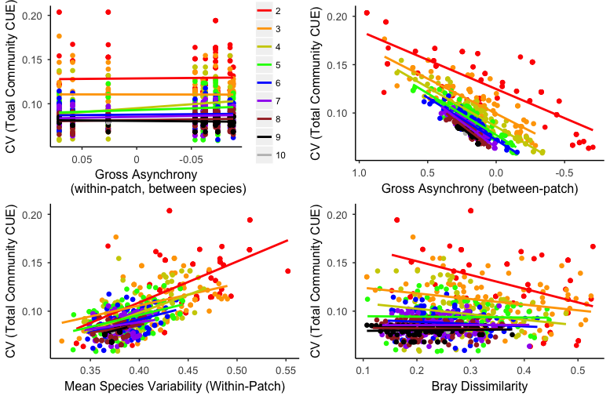
Random aggregations. colours = number of local communities in the aggregation

Slide 34
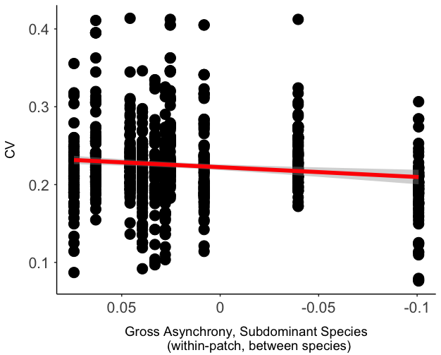
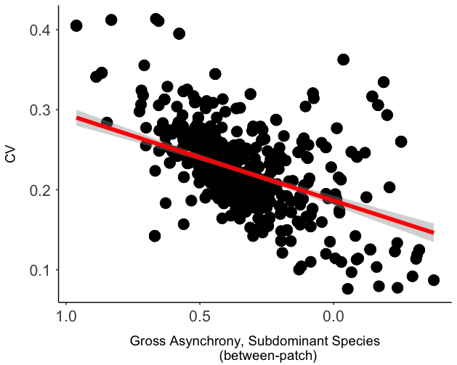
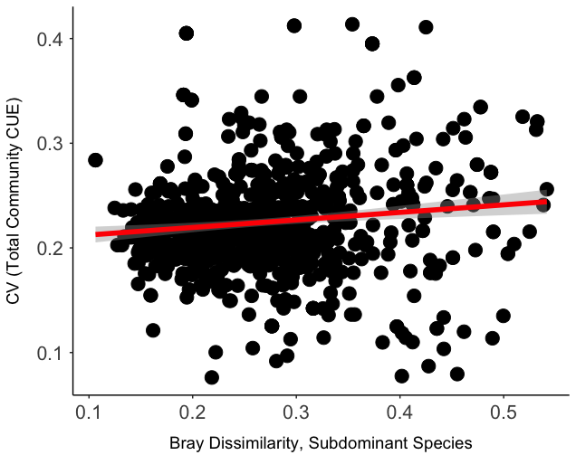
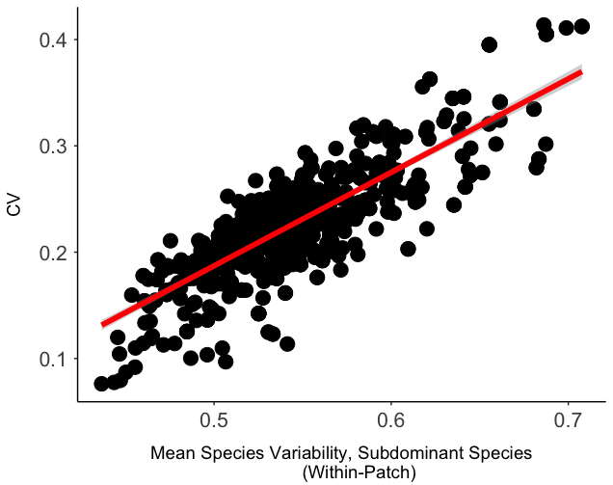
Local – Subdominant Species
Beta – Subdominant Species
Also using random aggregations, as per the previous slide.
Subdominant species: removed 4 most numerically dominant species (Arrowtooth, Halibut, Pollock, P. cod)
CV (Total Community CUE)
CV (Total Community CUE)
Asynchrony (between-species)
Asynchrony (between-patch)
CV (Total Community CUE)
CV (Total Community CUE)
Mean Species Variability (within-patch)
Species Turnover (Bray Dissimilarity)

Slide 35
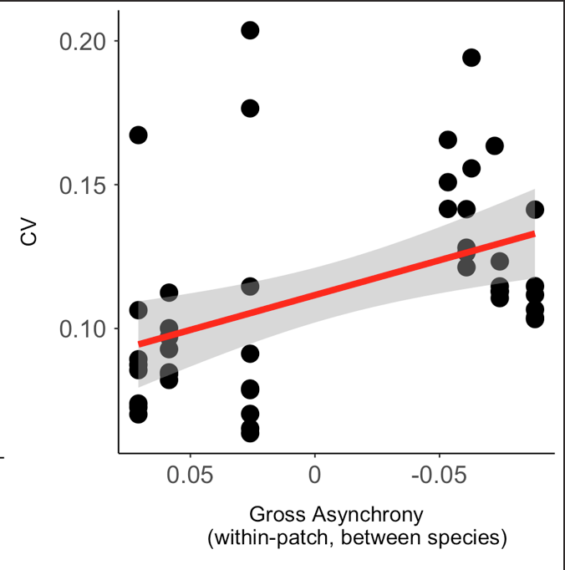
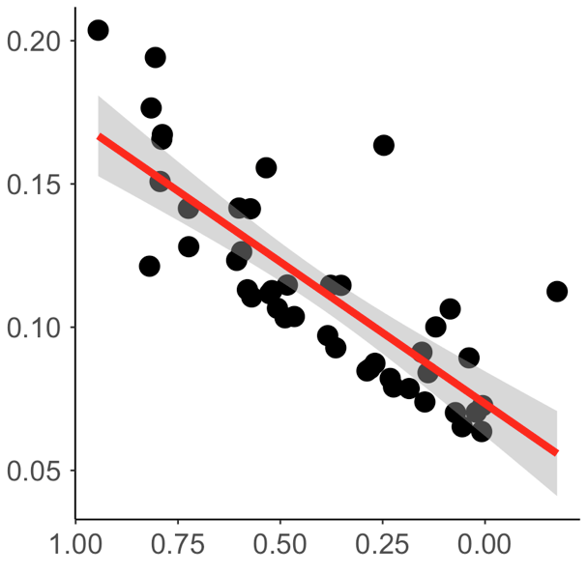
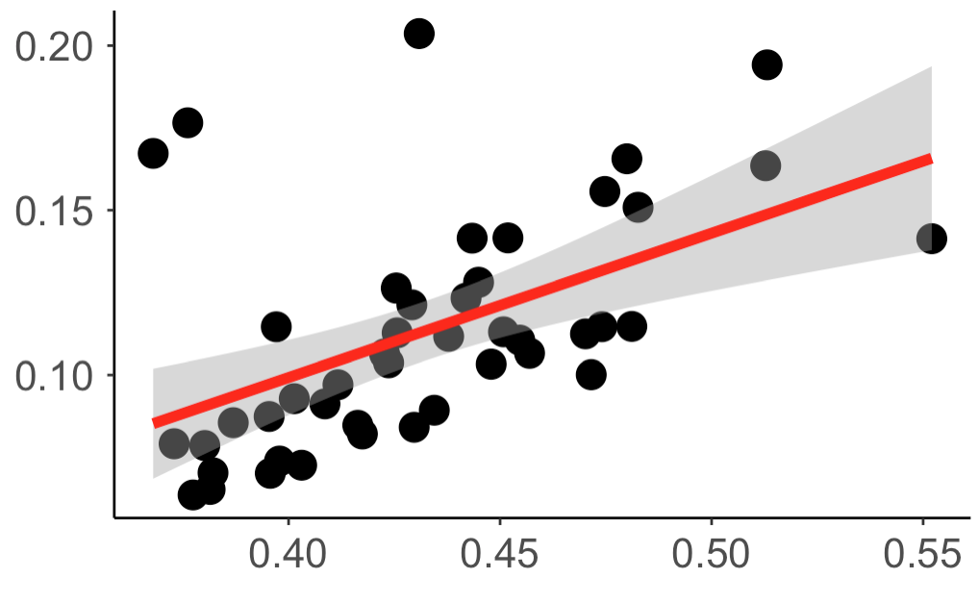
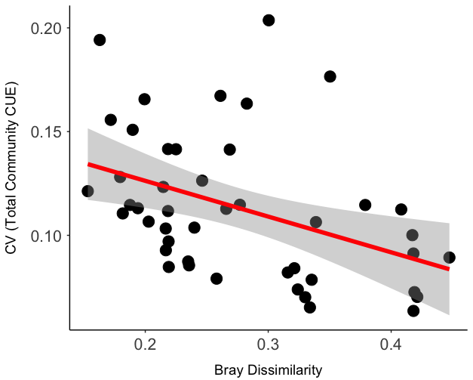
Local – Spatially Nested
Beta – Spatially Nested
Spatially nested aggregations of local communities (all possible combinations; these are not random draws)
e.g. 2 communities: 1+2, 2+3, 3+4, … 9+10
3 communities: 1+2+3, 2+3+4, ... 8+9+10
CV (Total Community CUE)
CV (Total Community CUE)
Asynchrony (between-species)
See notes
Asynchrony (between-patch)
p = 0.005 R² = 0.17
CV (Total Community CUE)
CV (Total Community CUE)
Mean Species Variability (within-patch)
Species Turnover (Bray Dissimilarity)
Notes:
All independent variables are significantly correlated.
Between-patch asynchrony & Bray dissimilarity are negatively correlated. This makes sense (communities that are more different should behave differently over time and be less synchronous). But which is the ultimate driver of CV? Logically, it must be Bray dissimilarity …

Slide 36
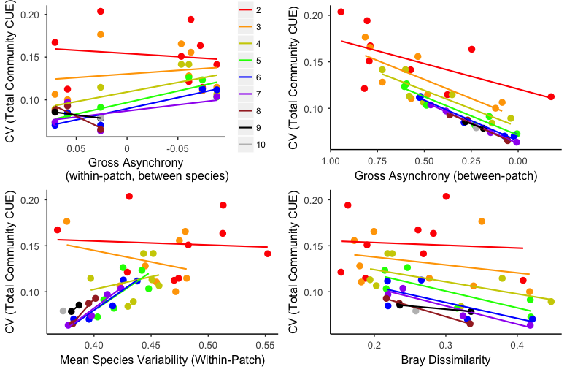
Spatially-nested aggregations colours = number of local communities in the aggregation
Notes:
Relationships are stronger with increasing scale of aggregation

Slide 37
Correlation structure among independent variables

Slide 38
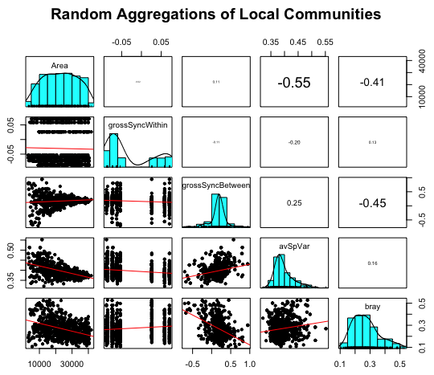
p <<< 0.001
Mean species var.
Notes:
Can we harness this correlation structure, and underlying causal relationships, into a neat analytical / conceptual framework for the paper?

Slide 39
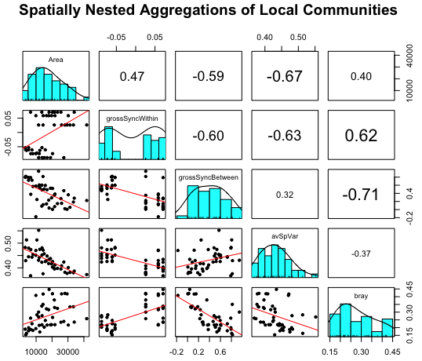
p = 0.02
Mean species var.
Notes:
Between-patch Synchrony & Mean Species Variability (within-patch) are positively correlated – perhaps communities with greater temporal variability (mean across species) are dominated by the same species, and would, as such, behave similarly re synchrony?
Between-patch Synchrony & Bray dissimilarity are negatively correlated - makes sense, likely a causal relationship (communities that are more different should behave differently over time and be less synchronous).
It’s feasible (but not necessarily true) that [Mean species variability] and [Bray dissimilarity] could be causally independent of each other, depending on whether species richness drives either variable (see a few slides below … both are related to species richness).

Slide 40
How do these correlations scale with the scale of aggregation?

Slide 41
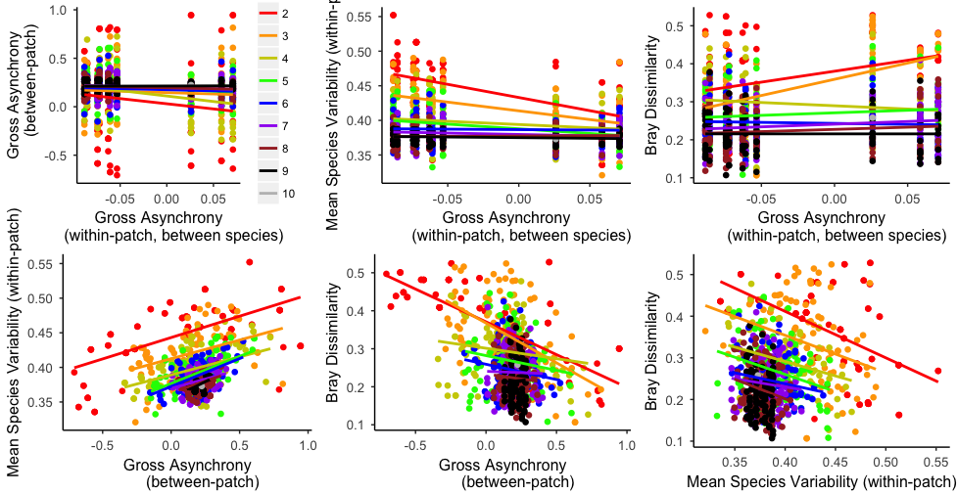
Correlations for Random aggregations. colour = number of communities in the aggregation
Notes:
Correlation between [Synchrony between-patches] & [Bray Dissimilarity] is only present for small aggregations

Slide 42
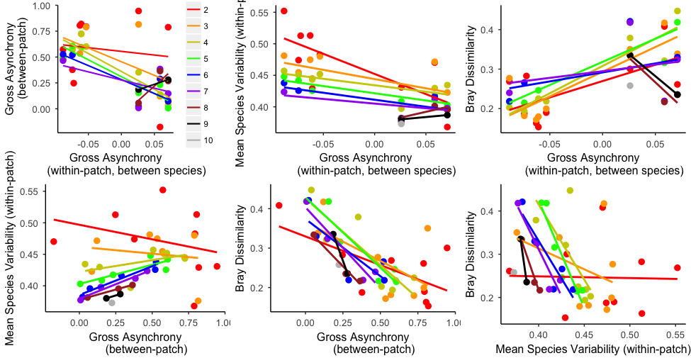
Correlations for Spatially-nested aggregations. Colour = number of communities in the aggregation

Slide 43
How do potential drivers of stability scale with Species Richness x Scale of Aggregation?

Slide 44
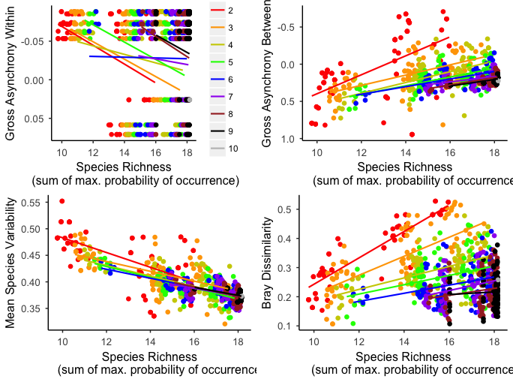
How do potential drivers of stability scale with Species Richness x Scale of Aggregation? Random Aggregations:
Notes:
Stronger relationship between Species Richness and Bray Dissimilarity with declining scale of aggregation. (note contrast to spatially-nested aggregations, next slide)

Slide 45
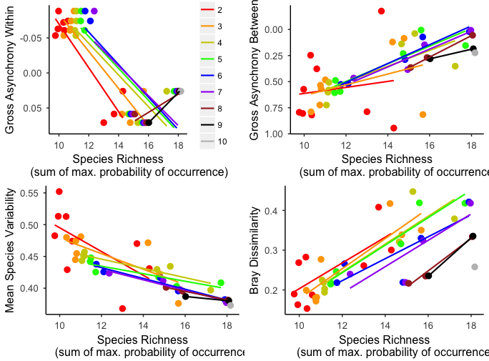
How do potential drivers of stability scale with Species Richness x Scale of Aggregation? Spatially-nested Aggregations:
Notes:
But strength of relationship between Species Richness and Bray Dissimilarity is invariant across scale of aggregation for spatially-nested aggregations. (note contrast to random aggregations)

Slide 46
Regional Stability
Local
Beta
Asynchrony between species
Species temporal variability
Asynchrony between communities
Spatial turnover in species identity
Diversity
modified from Wang & Loreau 2014 Ecol. Letts.
Notes:
Multiple pathways
looking only at a simple diversity-stability relationship at the regional level is not enough to understand what’s really going on and may not constitute best practices for informing management decisions

Slide 47
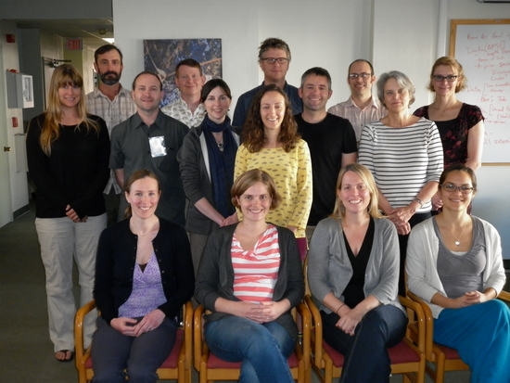
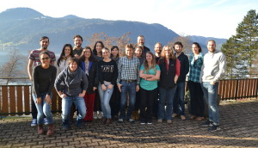
Thanks:
Gulf of Alaska Portfolio Effects Working Group (NCEAS)
Petchey Lab Group (University of Zürich)
NOAA RACE Groundfish Survey staff
Exxon Valdez Oil Spill Trustee Council & Science Panel
ward@nceas.ucsb.edu

Slide 48
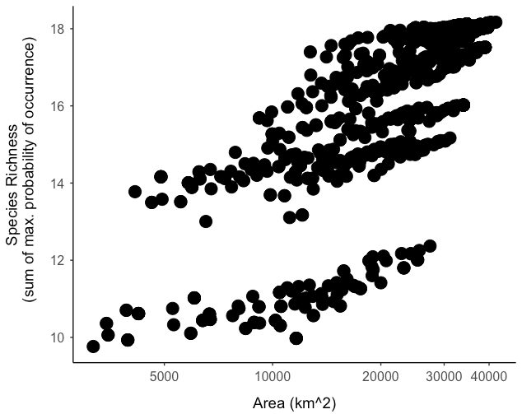

Slide 49
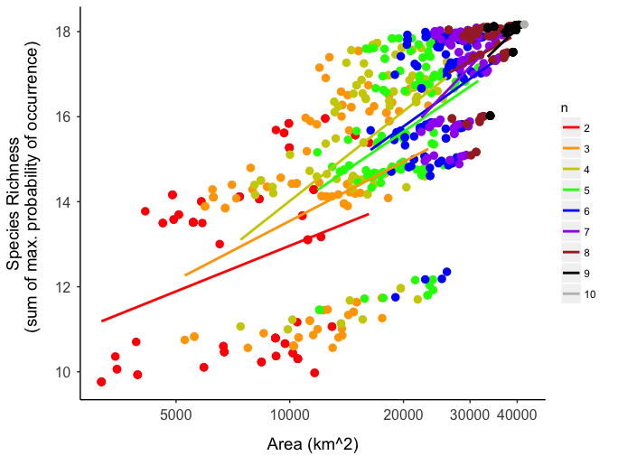
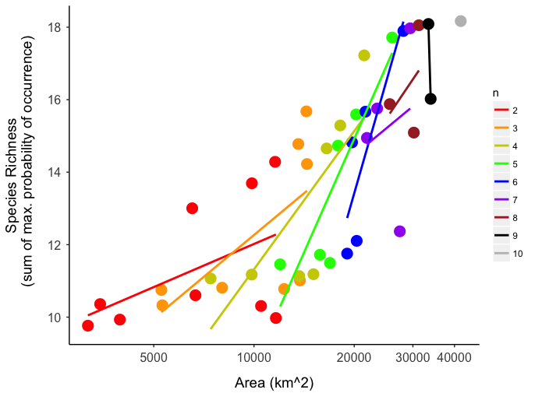
Random aggregations
Spatially-nested aggregations

Slide 50
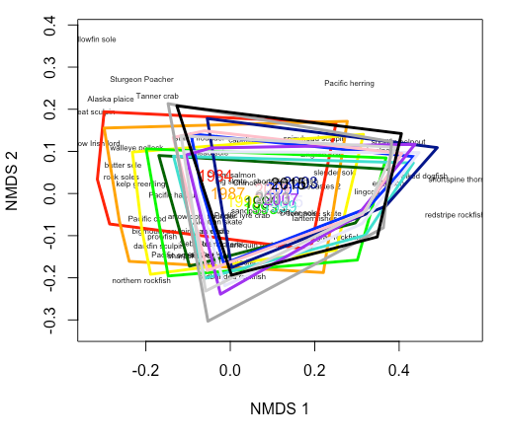

Slide 51
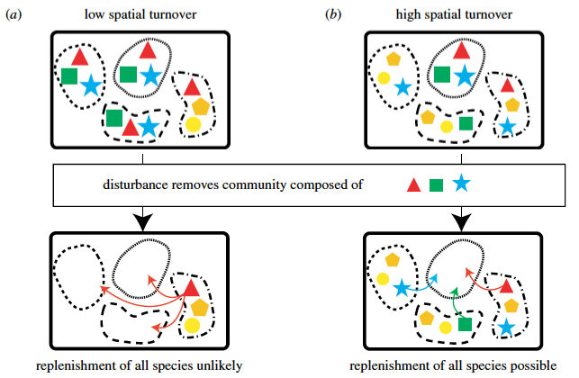
Mellin et al. 2014 Proc. R. Soc. B

Slide 52
Regional Stability
Local
Beta
Species asynchrony within patches
Species temporal variability within patches
Community asynchrony between patches
Spatial turnover in species identity
Diversity
Abundance
modified from Wang & Loreau 2014 Ecol. Letts.
Notes:
more specifically, decompose these local & beta components into …

Slide 53

Spatially-nested aggregations of local communities, for Subdominant Species
Subdom1 = remove 4 most numerically- dominant species (Arrowtooth, Halibut, Pollock, P. cod)
Subdom2 = remove 8 most numerically- dominant species (Subdom1 + Northern rockfish, Rock soles, POP, Flathead sole)
Subdom3 = remove the 2 numerically- dominant top predators (Arrowtooth, Halibut)

